Slide 1

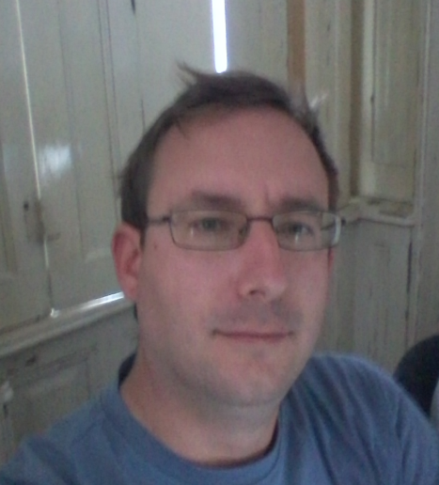
Péter JOLÁNKAI
2rd DEMO
20.10.2017
Pallida Cohort - Static Class
Hardware programing

Slide 2
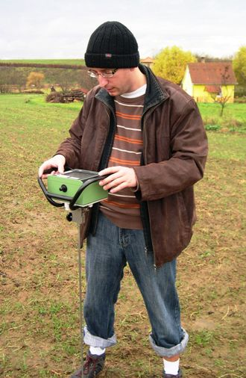
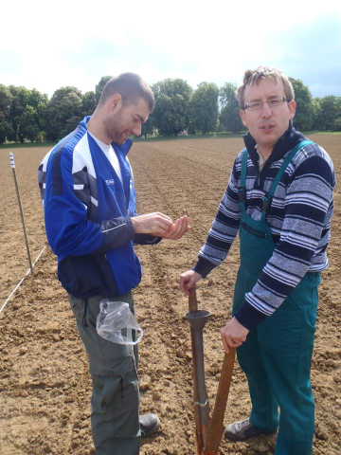
Introduction:
I am an agronomist, with university research background
and lecturing

Slide 3
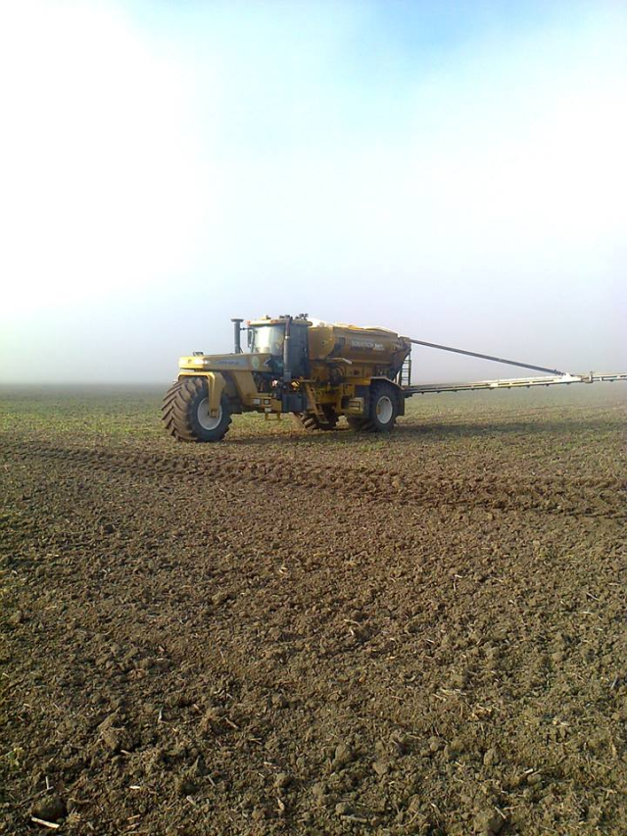

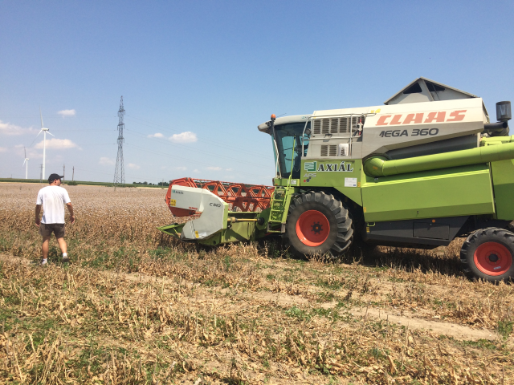
Later I worked for a company
as an agronomist
for producing medical plants

Slide 4

And now I am in a boot camp learning for junior
Hardware programmer at the Green fox Academy.

Slide 5
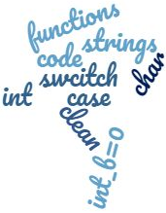


Slide 6
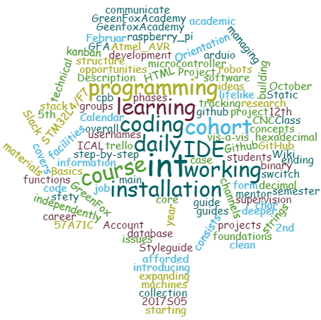

Slide 7

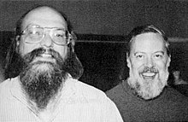
Last week we started the basics of C language

Slide 8
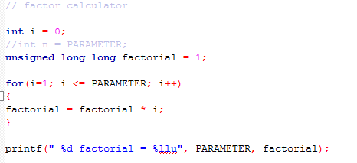

Slide 9
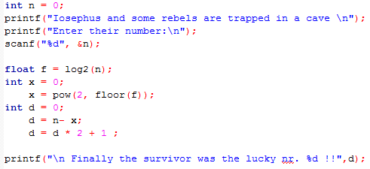

Slide 10
Thank you for your attention!

